Slide 1
Solution Overview / Daily Operation / Troubleshooting
zScaler Operations Guide

Slide 2
What is zScaler?
Real time scanning of traffic between users and the internet to protect against:
Virus/Malware
Spyware
Botnet
Inappropriate content
Phishing sites
More ‘real time’ than antivirus as zScaler nodes are continually updated with threat intelligence so that new threats are blocked immediately to all users without updates needing to reach the client
Good summary video

Slide 3




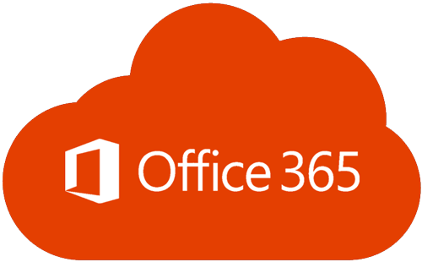



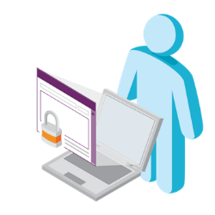
Deployment Visualized
Traffic to Internet
Handoff to Azure
Network
IPSec to
Primary ZEN
IPSec to
MPLS
IPSec to
Secondary ZEN
AT&T Netgate
Mobile User
Bacardi Office

Slide 4
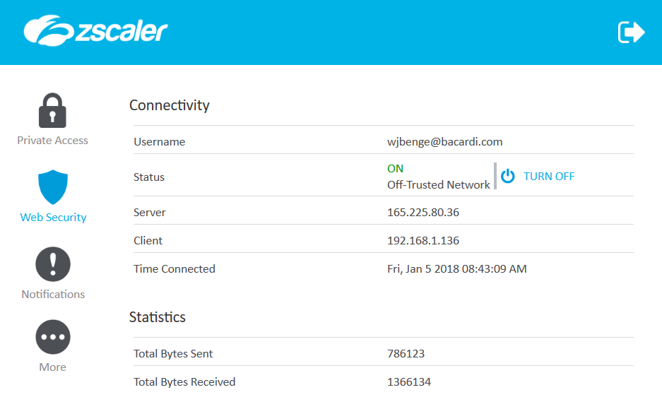
zScaler Agent
Private Access
Only seen by authorised users
Connection Status
ON – When working remote
OFF – On corporate network
Will be ON for locations without ANIRA
Logout & Turn Off
Password protected functions, password will only be released in emergency and must be kept confidential

Slide 5
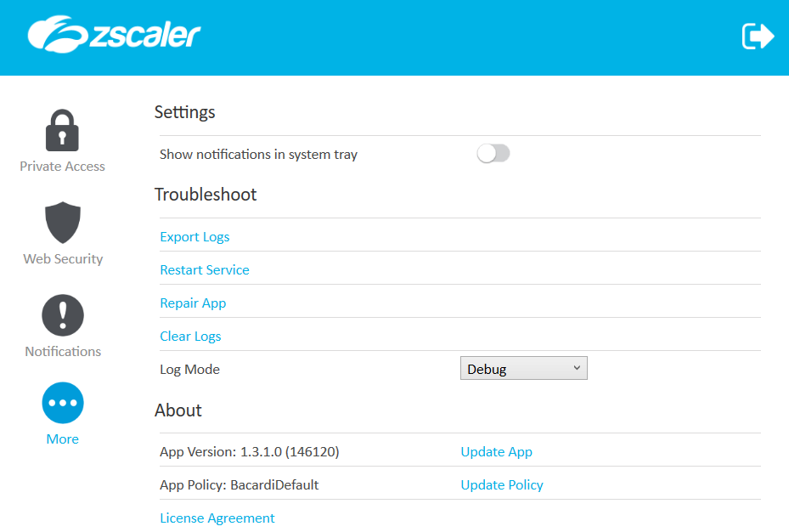
zScaler Agent
Export Logs
If requested for support purposes
Restart Service
Used to restart the Windows service if needed
Notifications
Here you can see basic log information for the app status
Repair App
Only use if instructed
Update App
Should not be required – app updates controlled centrally
Update Policy
May occasionally be needed if a rule is modified and it needs to be applied immediately

Slide 6
How is it deployed?
Locations with AT&T Netgate/ANIRA (not Cisco ANIRA)
IPSec Tunnel to AT&T for network access (backup or primary)
2 x IPSec Tunnel to zScaler nodes in country or proximate country
Locations without AT&T Netgate ANIRA
zScaler Agent will be ‘always’ live and route traffic from client to zScaler
Users outside of the office
zScaler Agent will become ‘live’ outside of the Bacardi network and route traffic from client to zScaler

Slide 7
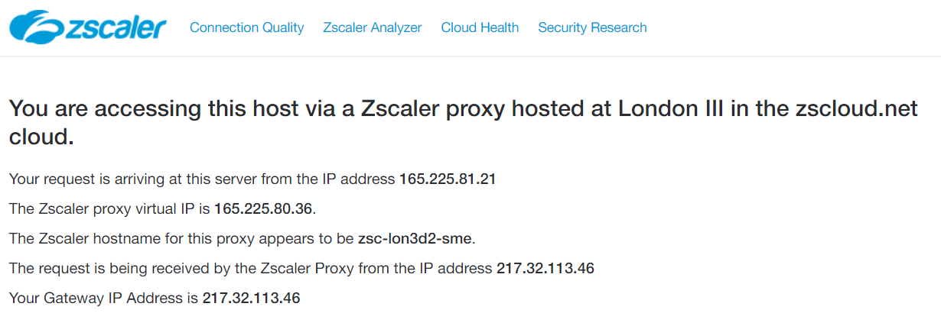
Troubleshooting
http://ip.zscaler.com
This should be your first port of call for any troubleshooting
Client and Gateway Details

Slide 8
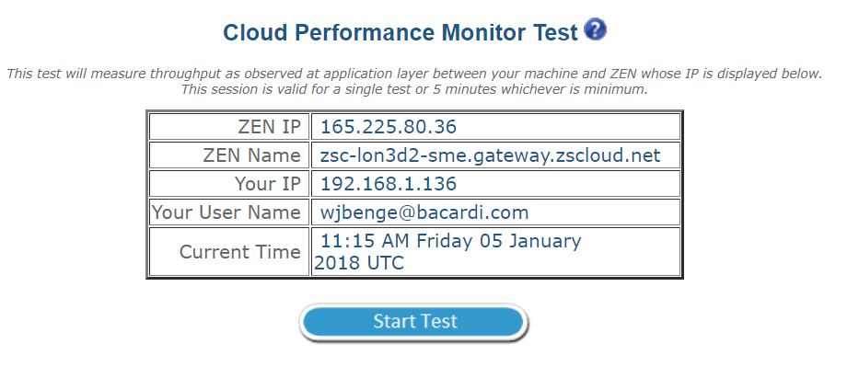
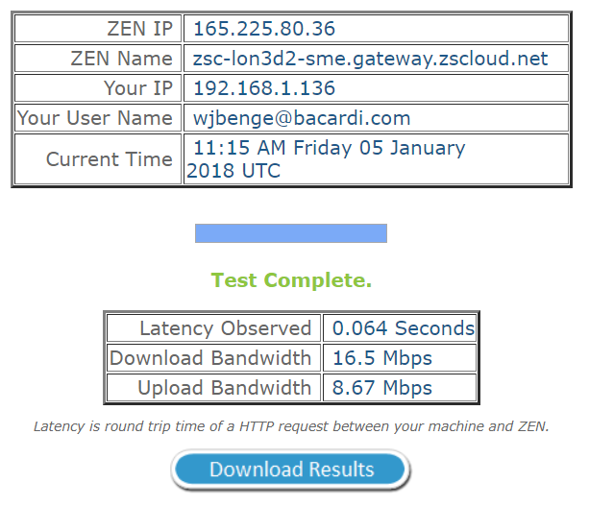
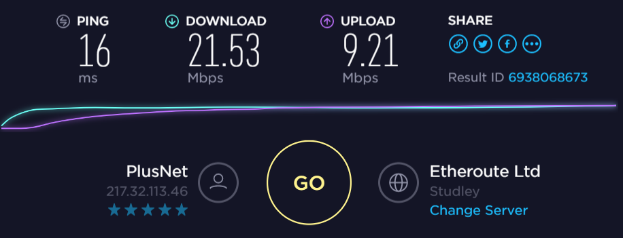
Troubleshooting Continued
Performance should be broadly similar to raw internet, potentially with a little extra latency which should not be noticeable during normal browsing.
On contended networks (in the office when there are other users browsing) you should not expect to see the full circuit performance.

Slide 9
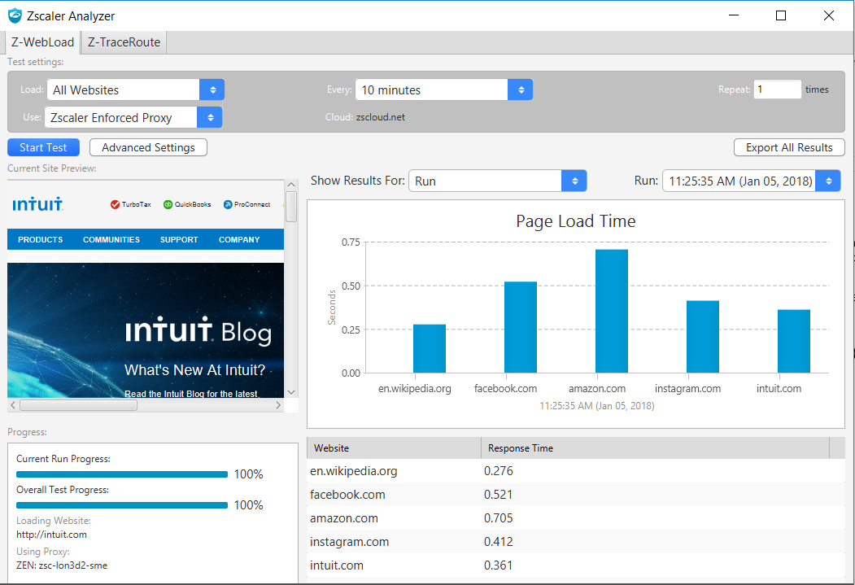
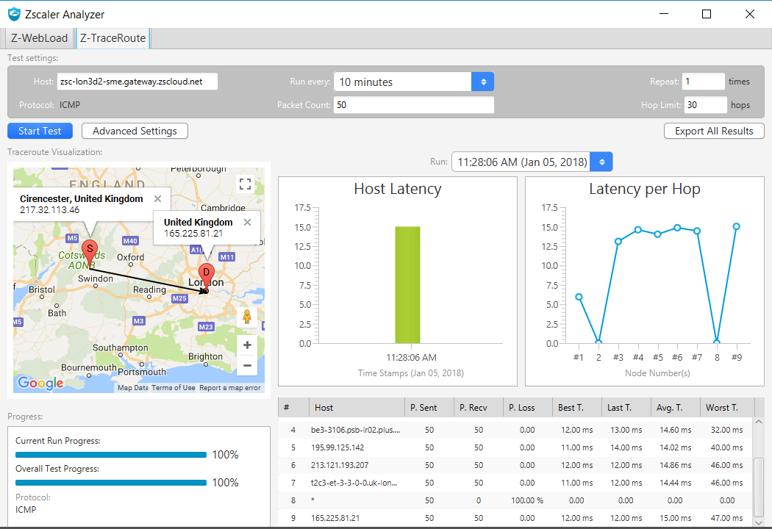
Troubleshooting Continued
This allows you to download an advanced testing tool (requires Java) which can test page load times and latency of all hops enroute to the ZEN Node. This should rarely be installed on user computers without guidance from Network & Collaboration Team

Slide 10
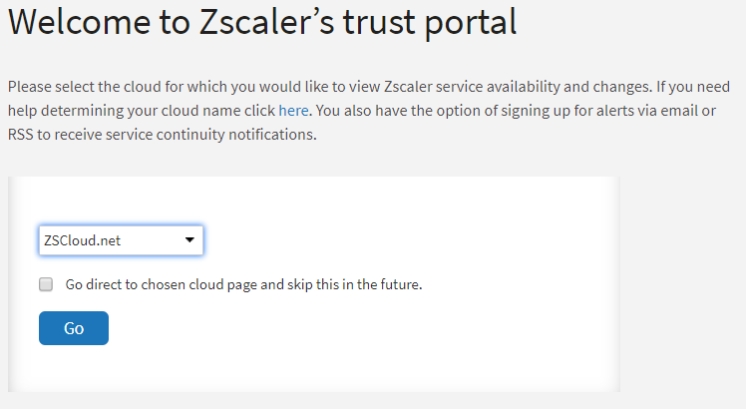
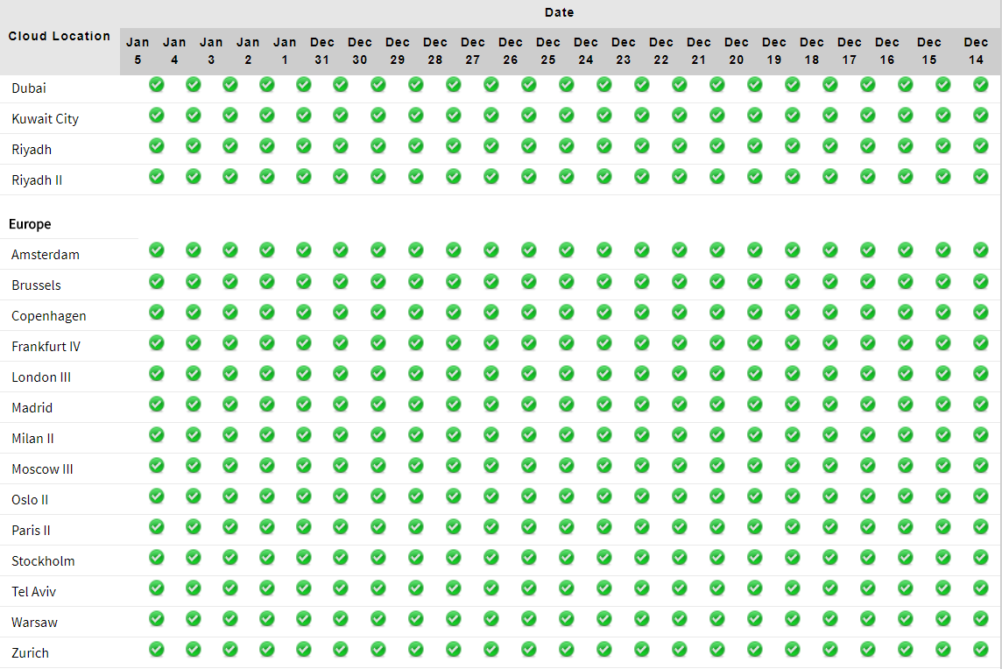
Troubleshooting Continued
Once you know the ZEN Node you are connected to, you can check it’s health though ‘Cloud Health’

Slide 11
Frequently Asked Questions
How does the zScaler app know if the machine is on/off Bacardi network
By looking at DNS servers
DHCP DNS for all ANIRA sites has an additional DNS server configured 10.137.39.56. When this is present the client knows that it is on Bacardi network and disables the agent

